Slide 1

Data-Driven Insights into Technology Trends, Salaries, and Job Demand
Nicholas Vergara
June 17th, 2026

Slide 2




OUTLINE
Executive Summary
Introduction
Methodology
Results
Visualization – Charts
Dashboard
Discussion
Findings & Implications
Conclusion
Appendix

Slide 3

EXECUTIVE SUMMARY
Summarize key findings here
Examined technology trends, salaries, and job demand across locations and programming languages
Washington DC, Detroit, and Seattle recorded the highest numbers of job postings
Python commands the highest average salary ($114k+)
Swift offers the highest average salary overall ($130k+)
JavaScript and Java remain highly valued skills
Demand for modern programming languages continues to increase
Geographic location significantly influences employment opportunities
Technology professionals should prioritize high-demand languages to maximize career growth

Slide 4

INTRODUCTION
Purpose of the report, Target Audience & Value of the analysis
Analyze global technology trends and labor market demand
Identify the most popular and highest-paying programming languages
Understand regional variations in job opportunities
Provide insights for students, professionals, and hiring organizations
Support data-driven career decisions
Highlight emerging technology trends

Slide 5

METHODOLOGY
Data sources, Data collection & Data wrangling steps
Collected data from Stack Overflow developer surveys
Cleaned and transformed datasets using data wrangling techniques
Aggregated salaries and job counts by technology categories
Created visualizations and dashboards to summarize findings
Removed missing and duplicate records
Standardized categories and formats

Slide 6
Results

Slide 7
JOB POSTINGS

Slide 8
POPULAR LANGUAGES

Slide 9
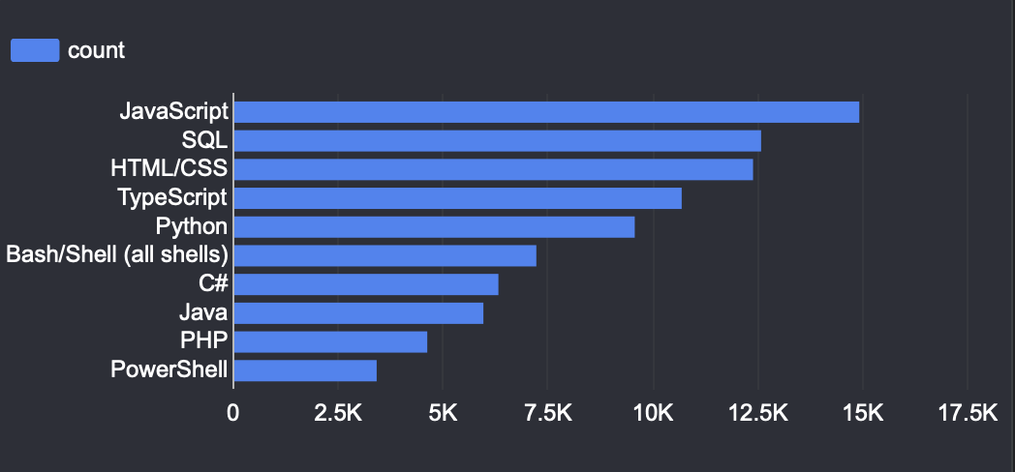
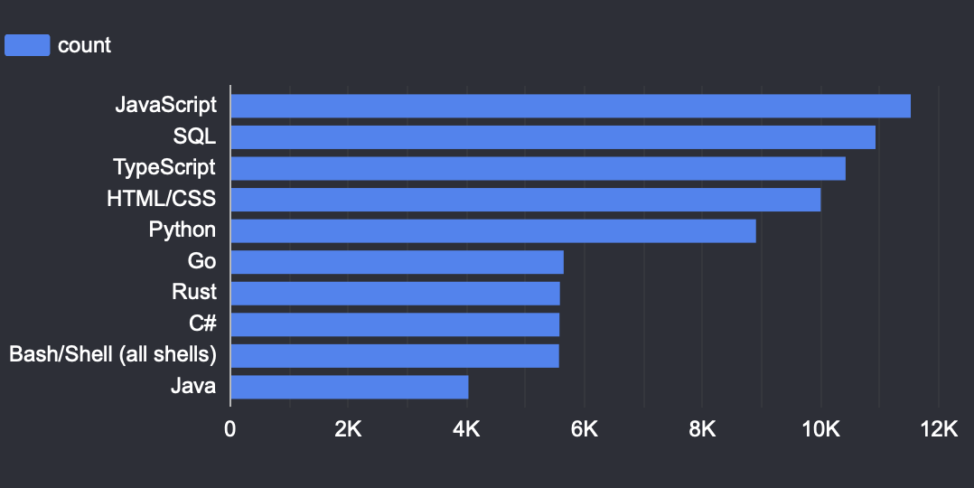
PROGRAMMING LANGUAGE TRENDS
Summarize key trends shown in the charts.
Current Year
Next Year

Slide 10
PROGRAMMING LANGUAGE TRENDS - FINDINGS & IMPLICATIONS
Findings
Python and Swift provide the highest average salaries
JavaScript and Java remain widely adopted
Salary differences across languages are substantial
Implications
Learning Python can improve earning potential
Organizations should invest in modern skill development
Professionals should combine multiple languages for versatility

Slide 11
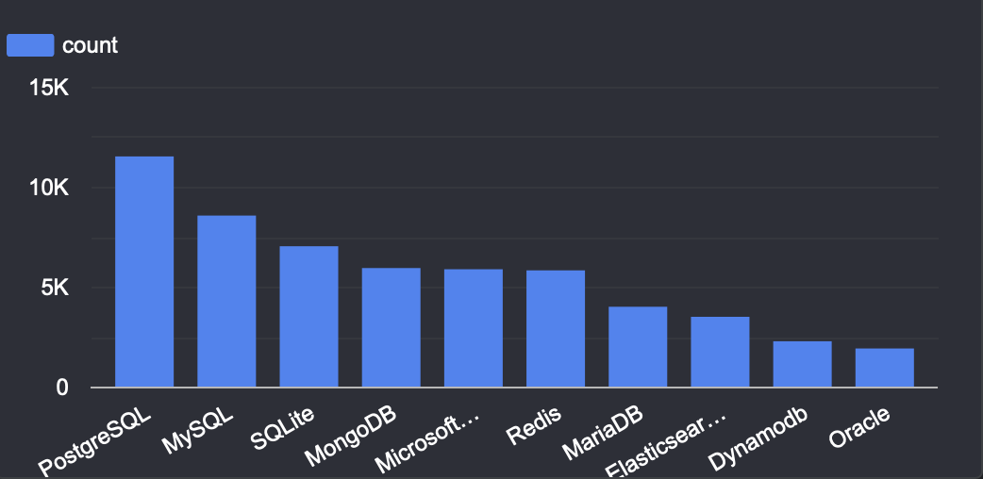
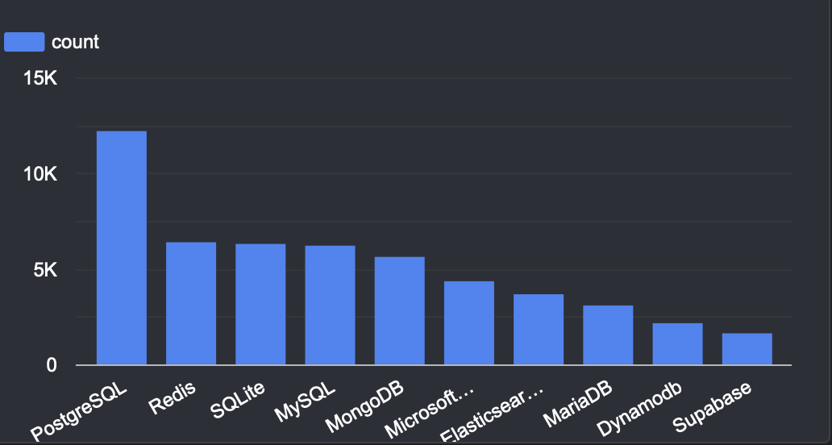
DATABASE TRENDS
Summarize key trends shown in the charts.
Current Year
Next Year

Slide 12
DATABASE TRENDS - FINDINGS & IMPLICATIONS
Findings
SQL-based systems continue to lead adoption.
Cloud databases show increasing popularity
NoSQL databases are gaining traction
Implications
Database professionals should develop cloud skills
Organizations need hybrid database strategies
Demand for data engineering expertise will continue rising

Slide 13

DASHBOARD

Slide 14
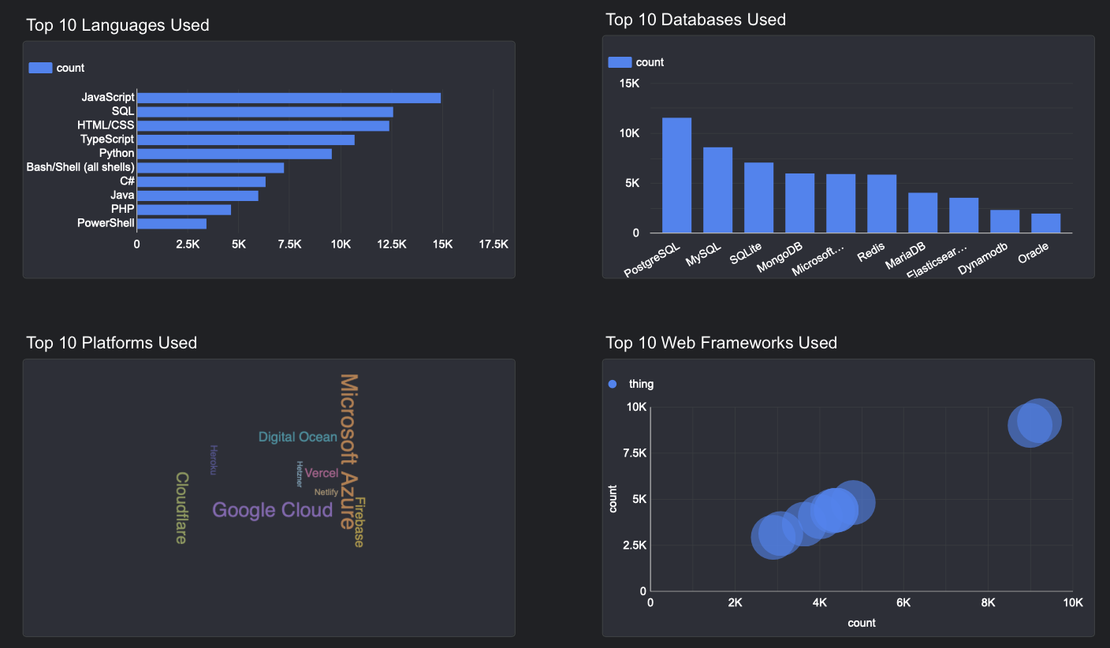
DASHBOARD TAB 1: Current Technology Usage
JavaScript, Python, and SQL remain widely used technologies
Most respondents work with multiple programming tools

Slide 15
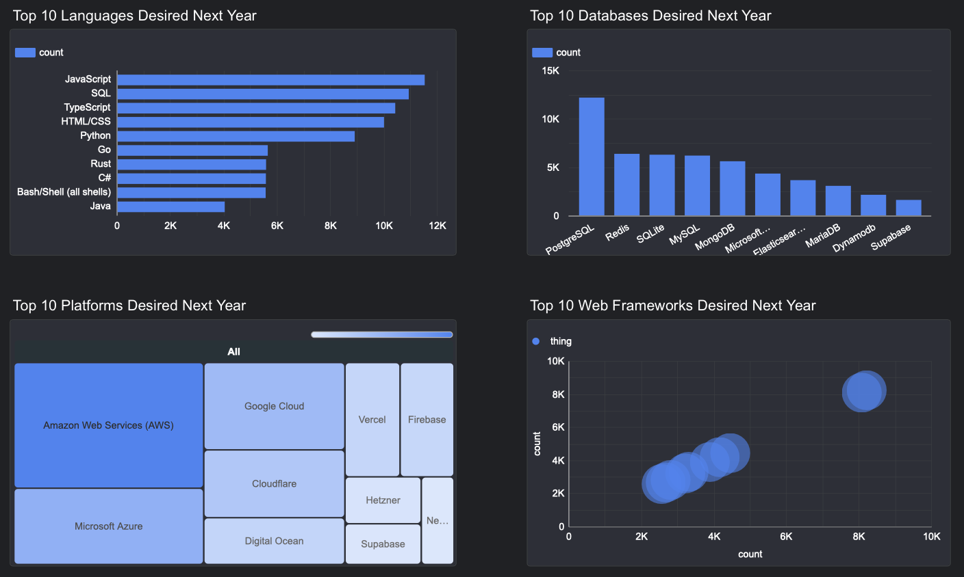
DASHBOARD TAB 2: Future Technology Trends
Emerging technologies are expected to experience continued growth
Demand for cloud, AI, and data-related skills is increasing

Slide 16
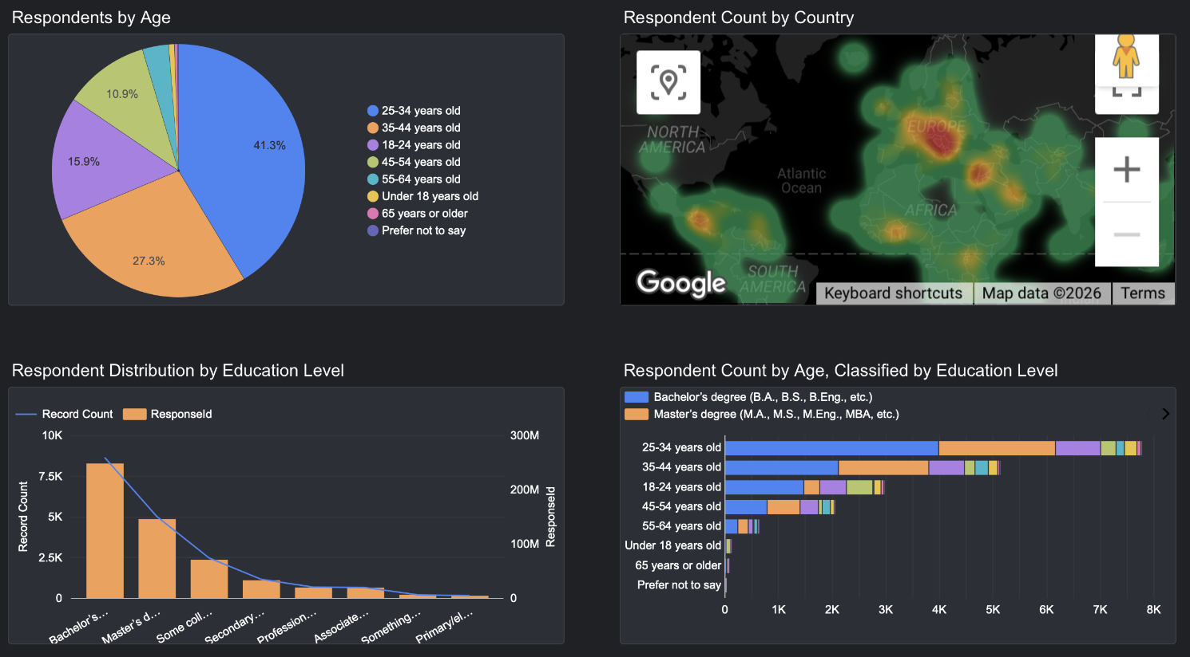
DASHBOARD TAB 3: Demographics
Respondents come from diverse backgrounds and experience levels
Technology adoption varies across regions and age groups

Slide 17
DISCUSSION
The technology industry continues to evolve rapidly
Salary and job opportunities vary significantly by skill and location
Python, JavaScript, and SQL remain critical competencies
Emerging technologies present strong opportunities for future growth
Continuous learning is essential for career success

Slide 18
OVERALL FINDINGS & IMPLICATIONS
Findings
Demand for technology professionals remains strong
Python and Swift provide the highest average salaries
Geographic location affects employment opportunities
Implications
Professionals should prioritize high-demand skills
Employers must adapt to changing technology trends
Upskilling and continuous learning are key competitive advantages

Slide 19

CONCLUSION
Technology trends continue to shape labor market demand
Python, JavaScript, and SQL remain among the most important skills
High-paying opportunities exist for professionals with specialized expertise
Data-driven insights can guide better career and organizational decisions

